Slide 1
BFX_UA300 FFC cable issue 8D report
FOXCONN CPEG JBD_VN
2022-Oct-06

Slide 2
D1. Establish the Team
D1. Create the team
Team Leader
Team Member
Foxconn
  MFG Manager : David Yin
  QA Manager : CB Lin/ Toney.HB
PM: Ben Zheng, An QA
PD: Ruan Wen Yong
QA: Rachel Ruan
PE: Michael Ruan
ME: Cheng Lun, Wen Thai
RD: Sean, Tom

Slide 3
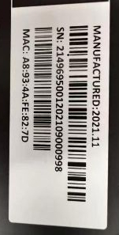
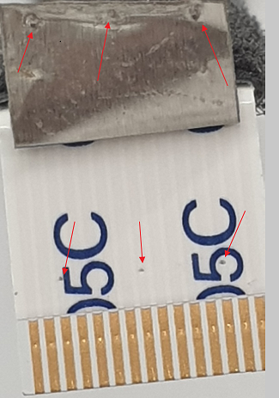
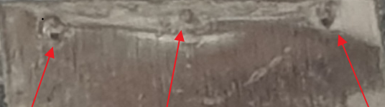
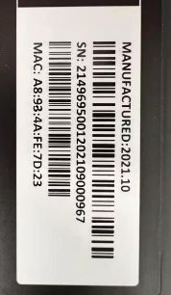
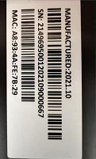
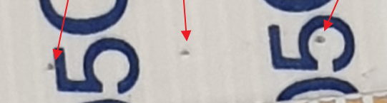
D2. Description of Problems
1. Issue Description
24-Nov-2021, ALT compliant that 3 units BFX-AU300 - FFC Cable Connection Fail .
No. | SN | Label Product | Production date | Failure Description Feedback from Customer
1 | A8934AFE827D |  | 01-Nov-2021
2 | A8934AFE7D23 |  | 18-Oct-2021
3 | A8934AFE7B29 |  | 03-Oct-2021

Slide 4
D2. Description of Problems
2. Production time and FFC cable DC of 03 units
No. | MAC | SN | Production Date | FFC cable PN | DC | Vendor
1 | A8934AFE827D | 2149695001202109000998 | 11/1/2021 10:04:37 AM | 376.00039.005 - 10 | 202140 | P-TWO
2 | A8934AFE7D23 | 2149695001202109000967 | 10/18/2021 8:57:27 AM |  | 2121.09.03
3 | A8934AFE7B29 | 2149695001202109000667 | 10/5/2021 1:34:55 AM |  | 2021.09.03
Result: 1. 3 units produced on Oct & Nov 2021.
2. FFC P/N : 376.00039.005 – P-TWO vendor. Date code is 202140 & 2021.09.03

Slide 5
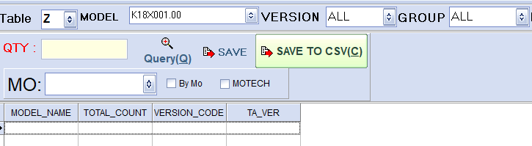
D3. Containment
1. Check production history of 3 units and FG stock
1.1 Assembly and function test data of 3 units are nomal.
Number | Production History
 | Product MAC | BT Station | PT Station | Assy 2 -> 4 | FT1 -> FT3 | RC1 -> RC2
1 | A8934AFE827D | 11/1/2021 10:09:22 AM | 11/1/2021 10:27:47 AM | 11/2/2021 9:31:07 AM | 11/2/2021 11:09:49 AM | 11/2/2021 11:28:01 AM
2 | A8934AFE7D23 | 10/18/2021 3:21:52 PM | 10/18/2021 3:24:24 PM | 10/20/2021 9:02:25 PM | 10/21/2021 1:01:53 AM | 10/21/2021 3:41:49 AM
3 | A8934AFE7B29 | 10/3/2021 5:35:48 AM | 10/3/2021 10:13:16 AM | 10/5/2021 1:35:47 AM | 10/5/2021 2:02:37 AM | 10/5/2021 4:17:35 AM
1.2 On Nov 24, 2021 all products shipped, no product in stock.

Slide 6
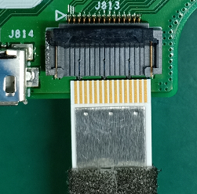
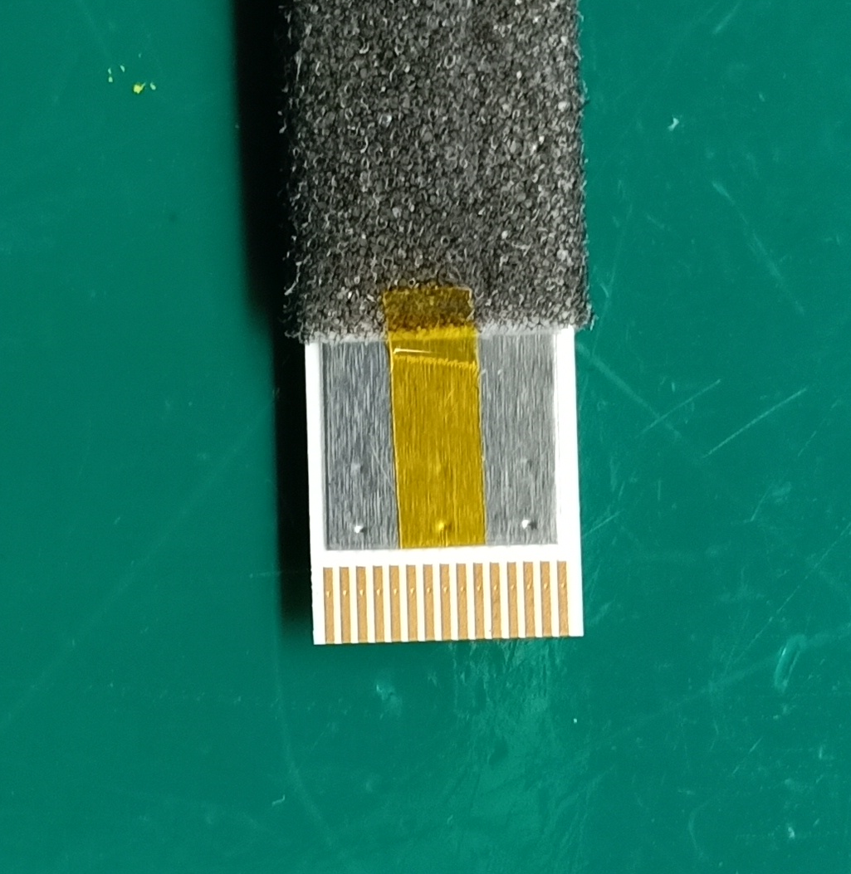


D3. Containment
2. Stick KAPTON TAPE on the middle of FFC cable to protect pin before insert FFC cable (Date: 2021.12.03)
Add the KAPTON TAPE (PN: 475.00050.005) in middle face of FFC cable
Before
After improved

Slide 7
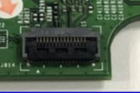
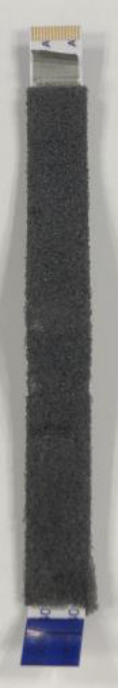
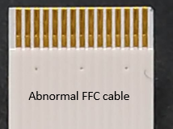
D4. Analysis Root Cause
1. Check visual inspection FFC Cable Connection Fail
1.1 Check visual inspection Connecter didn’t find abnormal issue.
FFC connecter
1.2 Check visual inspection FFC cable detected concave points on FFC cable and Pin 3/8/13 were pierced.
FFC cable

Slide 8
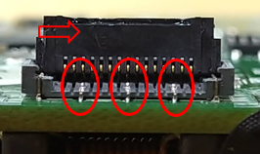
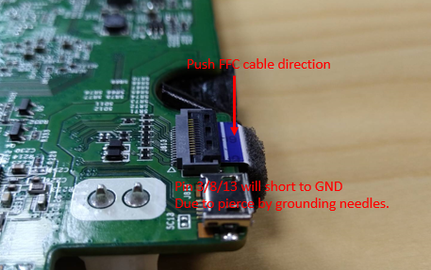

D4. Analysis Root Cause
2. Check FFC Cable Connection Fail
When insert FFC cable into AMP connector and press the bolt of connecter port to keep FFC cable, the grounding needles touch and pierce at pin 3/8/13 of FFC cable => It leads to short with GND.
FFC connector of AMP board
Grounding needles

Slide 9
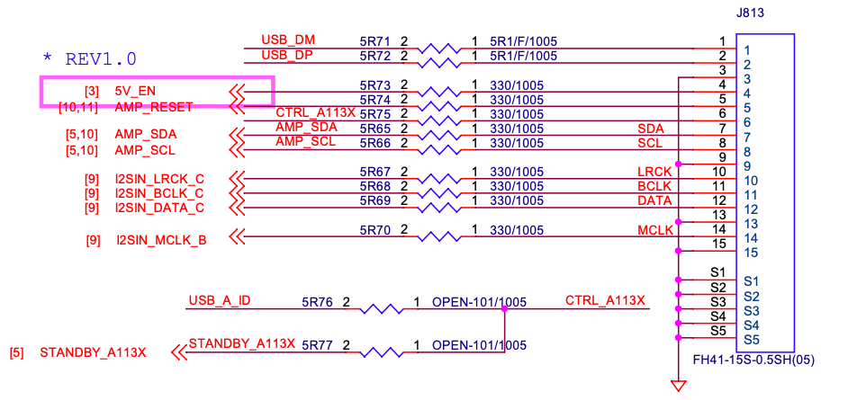
D4. Analysis Root Cause
3. FFC cable connector fail analysis
Base on circuit diagram, the pin 3,13 are GND and pin 8 is AMP_SCL signal.
Because, pin 8 is AMP_SCL signal, so when it shorts with GND due to pierced by grounding needle => It leads to FFC cable can not connect with AMP board.
AMP block connection diagram via J813

Slide 10
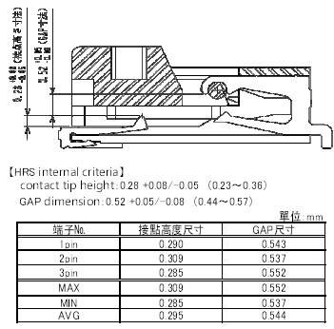
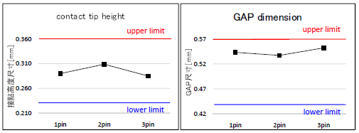
D4. Analysis Root Cause
4. Check contact tip height and GAP dimension of AMB connector on NG board From HRS vendor
Result : The contact tip height and Gap dimension meet criteria.

Slide 11
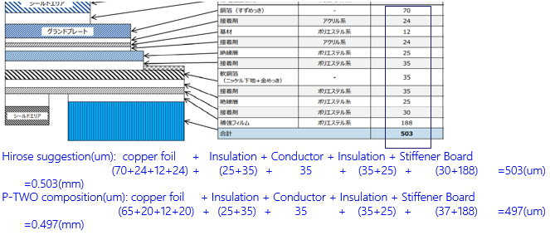
D4. Analysis Root Cause
5. Check GND plate (copper foil layer) Spec of FFC cable from P-TWO vendor and measurement result of the GND plate thickness of failure FFC cable from HRS vendor.
5.1 Check GND plate Spec of FFC cable from P-TWO vendor and P-Two vendor confirmed the spec GND plate thickness is 65 (um) in their FA report on 2021.12.01.

Slide 12
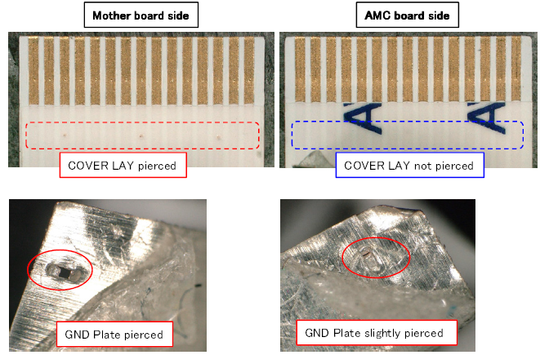

D4. Analysis Root Cause
5. Check GND plate (copper foil layer) Spec of FFC cable from P-TWO vendor and measurement result of the GND plate thickness of failure FFC cable from HRS vendor.
5.2 Measurement result of the GND plate (copper foil layer) thickness of failure FFC cable from HRS vendor.
The measurement result
Result : 1. Compare the P-TWO Spec (65um) and the actual measurement result from HRS vendor(44-43 um)=> the thickness of GND’s plate out of Spec.
2. Follow the HRS’s recommendation, the GND plate should be 72 um. However, the actual thickness of NG GND plate is only 60% (43-44 um) as HRS’s recommendation, it is too thin can not protect the FFC cable, the grounding needles can pierce through easy.

Slide 13
D4. Analysis Root Cause
6. Summary Root Cause
1. When insert FFC cable into AMP connector, the grounding needles (grounding needles made by metal) touch and pierce at pin 3/8/13 of FFC cable => It leads to short with GND and FFC cable can not connect with AMP board.
2. Because the GND plate thickness of FFC cable out of Spec, it is too thin, so the grounding needles can pierce through => it lead to FFC cable connects failure.
The conclusion: FFC cable connection failed, due to the material issue.

Slide 14
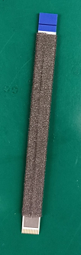
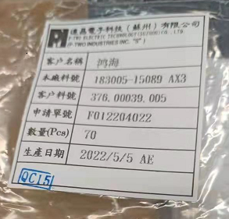
D5. Corrective Action
P-Two improve FFC cable by add one more layer is KAPTON TAPE below GNG plate layer to avoid AMP FFC cable pierced issue.
+ P/N : 376.00039.005
+ Vendor: P-TWO
+ Date code: 05/05/2022

Slide 15
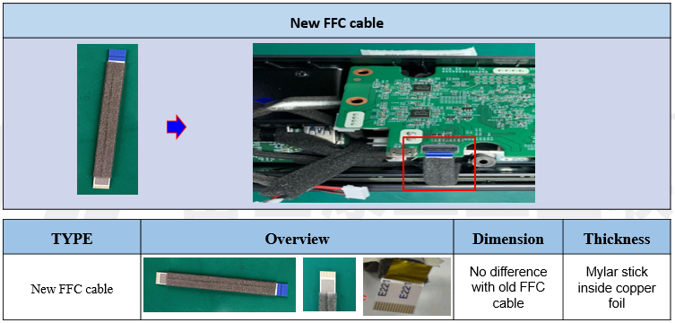
D6. Verification of Effectiveness
1. Fii use control run to verify 50 pcs new FFC cable with one more layer is KAPTON TAPE from P-TWO vendor
(D/C : 2022.05.05).
Result : After finished 50 units control run, Fii didn’t find any connection failure issue relate new FFC cable.

Slide 16


D6. Verification of Effectiveness
2. Reliability test for FFC cable
5pcs FCC Static Pressure Load Test: Pass.
2pcs FFC Cable HALT Test: Pass.

Slide 17
D7. Prevent Recurrence
After FFC cable improved, no similar issue found.
After reviewed the other FFC cables, no similar issue.

